Slide 1
Intro Story

Slide 2
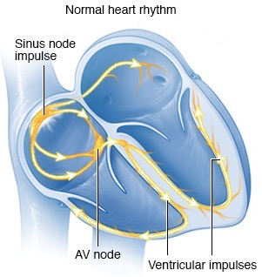
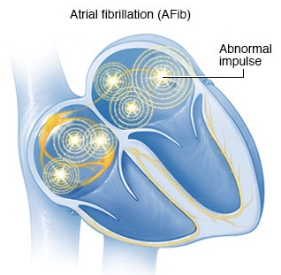
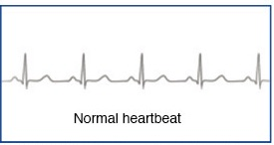
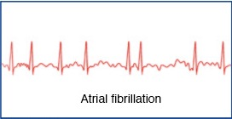
Atrial Fibrillation
[noun] a heart condition that causes an irregular and often abnormally fast heart rate. (NHS,2020)
Atrial Fibrillation is a heart-rhythm-related disease

Slide 3

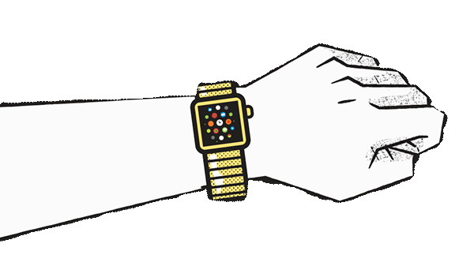
Atrial Fibrillation
130,000
Death each year in US 🇺🇸
Notes:
AFib (Atrial Fibrillation) is heart-rhythm-related disease that kills 130,00 people in US each year.
By collecting data generated

Slide 4

Heart rate data
Detect irregular rhythm
insights
Diagnose
Treatment
Data generated from wearable devices would help combat Atrial Fibrillation
Notes:
By collenting Data generated from wearable devices with electrical heart sensors, such as… ECG apps, iwatch (monitoring heart rate) could help doctors detect irregular heart pattern in advance, alert patients receiving treatment in time.

Slide 5
Heart rate data
Fitness tracking app Strava gives away location of secret US army bases (Gradian, 2018)
Notes:
What you are looking at now is a heatmap visualized by aggregating GPS data from fitness tracker, Strava.
Turns out that by focus those data by of military personnel only, Spies can expose where US military base.

Slide 6

“The Department of Defense takes matters like these very seriously and is reviewing the situation to determine if any additional training or guidance is required”.
-- the Pentagon

Slide 7
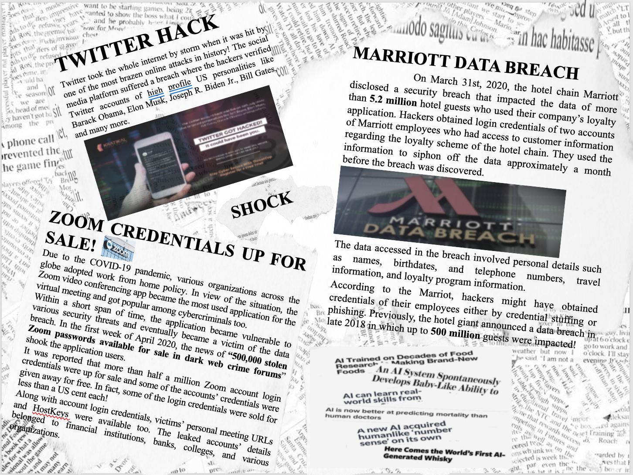
Regulatory Whiplash
Ethical foresight may reduce the probability of regulatory whiplash (Mittelstadt & Floridi, 2006).
A situation when “overly restrictive measures (especially legislation and policies) are proposed in reaction to perceived harms, which overreact in order to re-establish the primacy of threatened values, such as privacy” (Mittelstadt & Floridi, 2006)

Slide 8
Responsible Innovations

Slide 9
Ethical Frameworks

Slide 10
Recommendations

Slide 11
Upstream Public Engagement (Wilsdon and Willis, 2004)
Obtains as much as possible knowledge on the consequence of outcomes (Von Schomberg, 2011) – Anticipate
Test of Deliberation (Lovbrand et al, 2011) – Engage
Notes:
Technique as such (Wilsdon and Willis, 2004) align with both Anticipate and Engagement
Responsible innovation requires innovators to obtains knowledges on the consequences of outcome and range of options, as much as possible (Von Schomberg, 2011). No one is an island. Analyst by-themselves are unlikely to achieve this.
Engage public stakeholders not only act as epistemology networks which helps analyst anticipate risks, but put organisation themselves objectives through test of deliberation (Lovbrand et al, 2011). Test of deliberation is seen crucial in achieving the objective of Engagement.
Wilsdon, J., & Willis, R. (2004). See-through science: Why public engagement needs to move upstream. Demos.

